Slide 1
An Evolutionary Approach for Image Segmentation
Alessia Amelio & Clara Pizzuti,
MIT Press Journals
Lin Huangjing, 1155072677
ENGG5189 Evolutionary Computation Paper Presentation

Slide 2

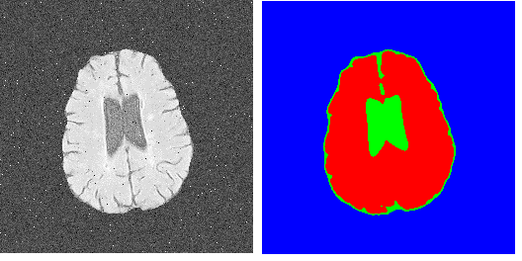
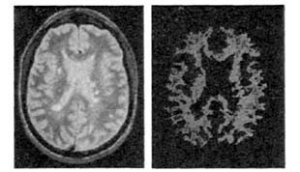
Background
What is segmentation?
Notes:
1.5 min
Non-overlapping regions

Slide 3
Motivation
Importance of the Segmentation
Central Problem in Pattern Recognition
Be widely used in medical diagnosis
Be useful in 3-D modeling
…..
Notes:
1 min

Slide 4
Objective
Objective:
Automatically
Higher accurate
More robust
Notes:
30 sec.

Slide 5
Problem Definition
Segmentation
Non-overlapping and connected regions
Homogeneity of clustered pixels
Intensity
Color
Texture
Notes:
1 min

Slide 6
Existing Approaches
Existing Approaches
Boundary detection-based approaches
Detect pixels that sensibly change in intensity
Limitation: a threshold value must be set
Region clustering-based approaches
Group similar close pixels into clusters
Fuzzy C-means or K-means
Limitation: the number of clusters must be set
Graph-based approaches
Notes:
Less than 1 min
Briefly

Slide 7

Existing Approaches
Graph-based Approaches by Shi and Malik
Normalized cut (Ncut)
Measure the dissimilarity between groups
K-means clustering algorithm to perform k-way partitioning
Notes:
Less than 1 min
Briefly

Slide 8
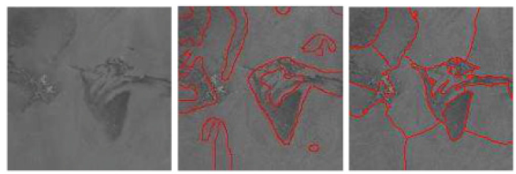
Existing Approaches
Graph-based Approaches by Shi and Malik
Strength
Transform the problem to a minimization problem
Weakness
The number of k should be set in advance
So sometimes this approach may be not such convenient to some degree, and the results may be not satisfactory.
Notes:
Less than 1 min
Briefly

Slide 9
Proposed Method Overview
Introduce in the Genetic Algorithm (GA)
Propose a novel dissimilarity evaluation function “Weight Normalized Cut (WNCut)” based on the previous “Ncut”
Automatically adjust the k number of objects without setting in advance
More better result than previous work
Notes:
1.5 min

Slide 10

Proposed Method Overview
Definition of Image
Define the image as a graph G = (V, E, W)
V → the set of n nodes of G
E → the set of edges
W → is a set of values corresponding to edges
1, 2, 3, …… 16
1
2
3
..
16
W is a Matrix calculated by w(i,j)
Represent the affinity between pixels
image ( n = 4x4 = 16 )
Notes:
1.5 min

Slide 11
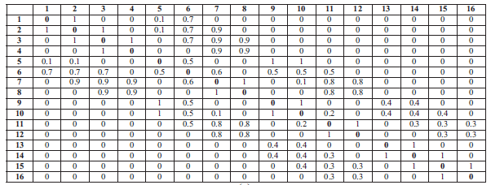
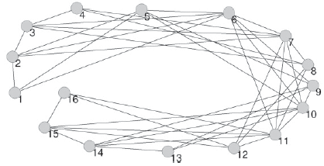
Proposed Method Overview
Definitions of Image
Notes:
1.5 min

Slide 12
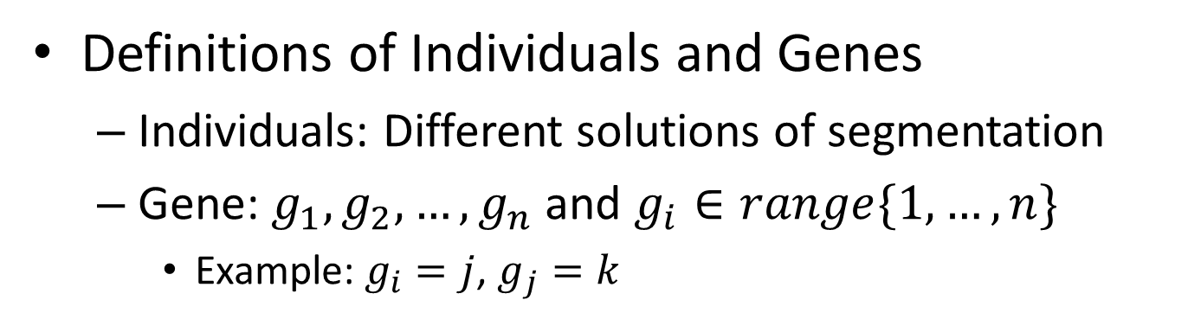
Proposed Method Overview
Definitions of Individuals and Genes
Individuals: Different solutions of segmentation
Gene: $g_{1}, g_{2},…, g_{n}$ and $g_{i}∈range\{1,…, n\}$
Example: $g_{i}=j$, $g_{j}=k$
i
j
k
Notes:
1.5 min

Slide 13

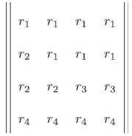
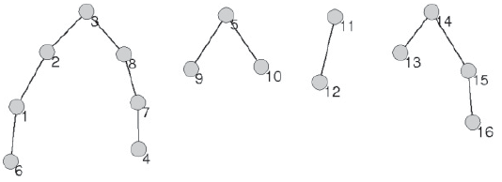


Proposed Method Overview
Definitions of Individuals and Genes
$$g_{i}:$$
j$:$
&
Notes:
1.5 min

Slide 14
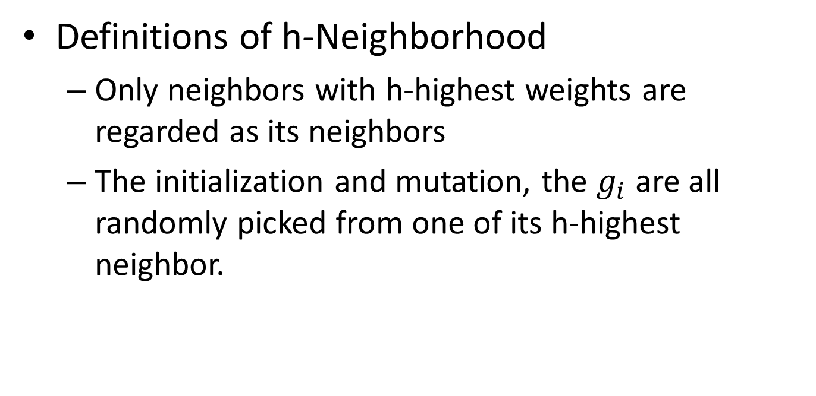
Proposed Method Overview
Definitions of h-Neighborhood
Only neighbors with h-highest weights are regarded as its neighbors
The initialization and mutation, the $g_{i}$ are all randomly picked from one of its h-highest neighbor.
Notes:
1.5 min

Slide 15
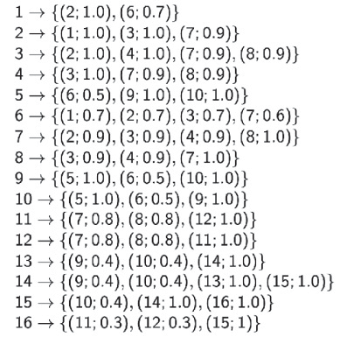
Proposed Method Overview
h=2, only neighbors with 2-highest weights are selected
Definitions of h-Neighborhood
Notes:
1.5 min

Slide 16
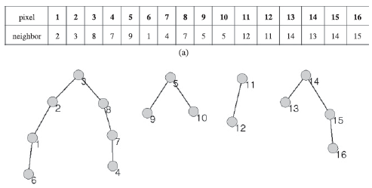
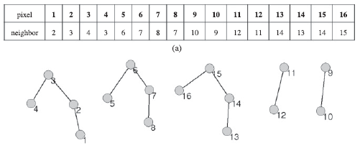
Proposed Method Overview
Definitions of Crossover
Two parent individuals
A mask is defined randomly
Example:
J1:
J2:
Notes:
1.5 min

Slide 17




Proposed Method Overview
Definitions of Crossover
J1:
Mask:
J2:
Result:
Notes:
1.5 min

Slide 18
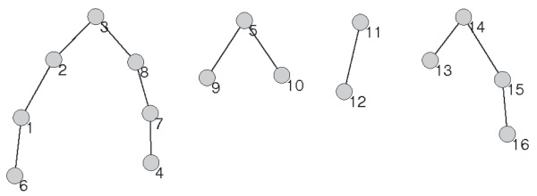
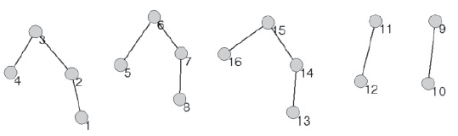
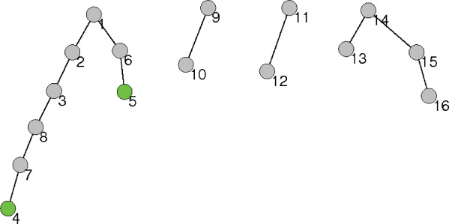
Proposed Method Overview
Definitions of Crossover
+
J1
J2
Offspring
Notes:
1.5 min

Slide 19
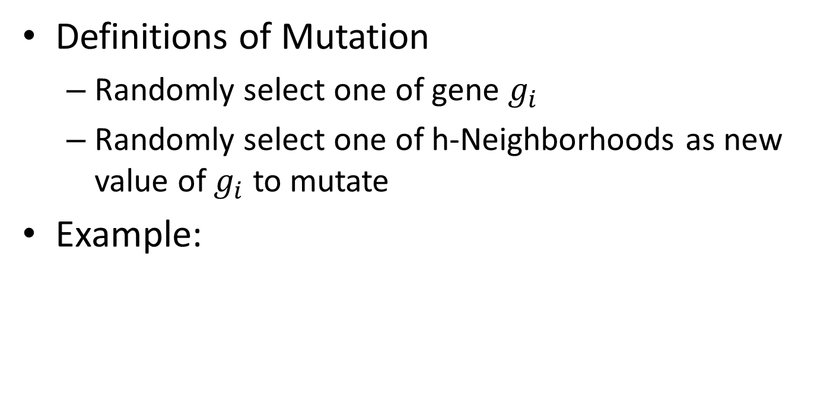
Proposed Method Overview
Definitions of Mutation
Randomly select one of gene $g_{i}$
Randomly select one of h-Neighborhoods as new value of $g_{i}$ to mutate
Example:
J1:
Notes:
1.5 min

Slide 20

Proposed Method Overview
Definitions of Mutation
J1:
Result:
Notes:
1.5 min

Slide 21
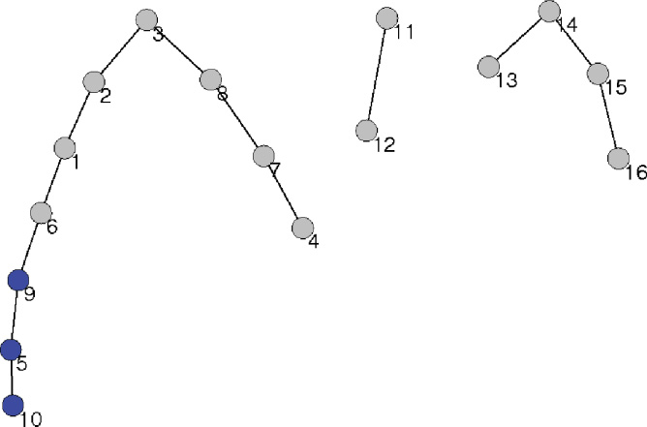
Proposed Method Overview
Definitions of Mutation
Mutation
Notes:
1.5 min

Slide 22



Proposed Method Overview
Evaluation Function of Method
WNCut function
To find the solution with minimal WNCut
Notes:
1.5 min
association

Slide 23
Proposed Method Overview
Algorithm
Pre-processing
Denoise
Resize
Segmentation
Converse to gray scale
Perform GeNCut calculation
Contour extraction
Resize to original size
Canny edge detection
Notes:
1.5 min
association

Slide 24
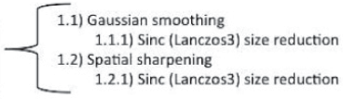
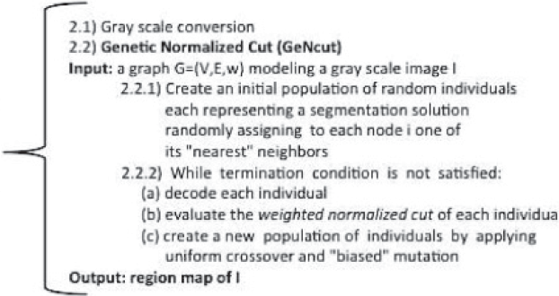

Proposed Method Overview
Algorithm
Input Image
Pre-Processing
Segmentation
Contour Extraction
Image Boundaries
Notes:
1.5 min
association

Slide 25

Mathematical Derivation
Weight Definition
Edge(x) is the image edge strength at position x
r is the distance threshold
line(i, j) is the straight line between i and j
Notes:
2 min

Slide 26
Mathematical Derivation
Weight Definition
Find the max Edge(x)
value on the line
r
i
j
Notes:
2 min

Slide 27





Mathematical Derivation
WNCut Definition
Improved from the Ncut proposed by Shi&Malik
Notes:
2 min

Slide 28







Running Example: Segmentation Step
Initialization:
$$J_{1}$$
$$J_{2}$$
……
$$J_{n}$$
Mark Down
Best Solution
Evaluation:
$${WNCut}_{1},{WNCut}_{2},…,{WNCut}_{n}$$
Crossover
&Mutation
$${J′}_{1}$$
$${J′}_{2}$$
……
$${J′}_{n}$$
Stop
N
Y
Result
Notes:
1 min

Slide 29
Experiments
Compare with Ncut method proposed by Shi&Malik
Different types of images have been tested
Synthetic image
Satellite image
Medical image
….
Overall evaluation based on Entropy
5 satellite images
10 medical images
9 miscellaneous images
Notes:
2 min

Slide 30
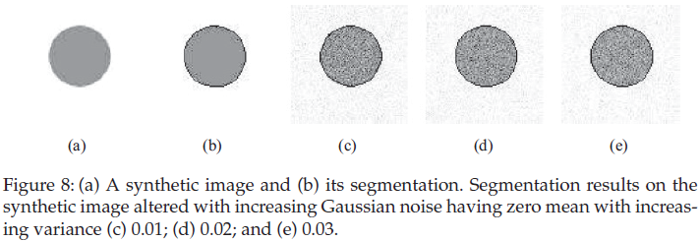
Experimental Result 1
Synthetic Image
Robust validation
Notes:
1 min

Slide 31
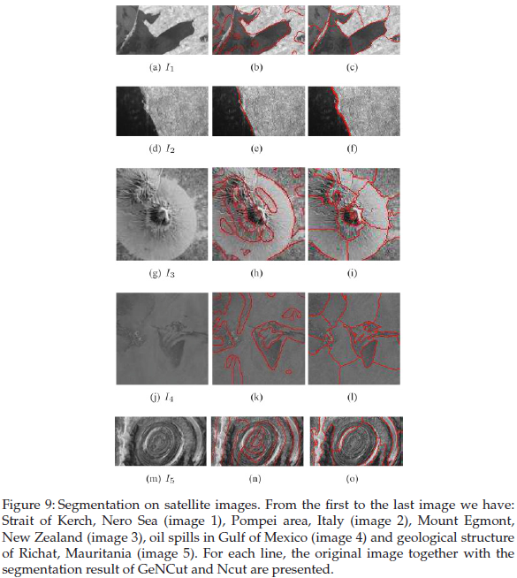
Experimental Result 2
Satellite Images
Compare with NCut
Notes:
1 min

Slide 32
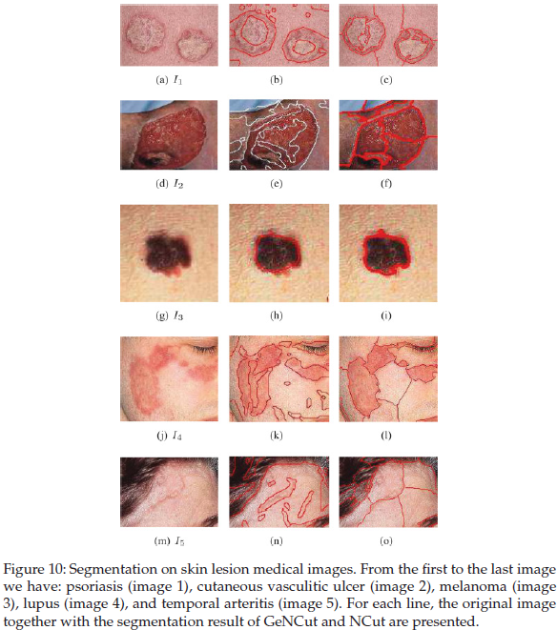
Experimental Result 3
Medical Images
Compare with NCut
Notes:
1 min

Slide 33
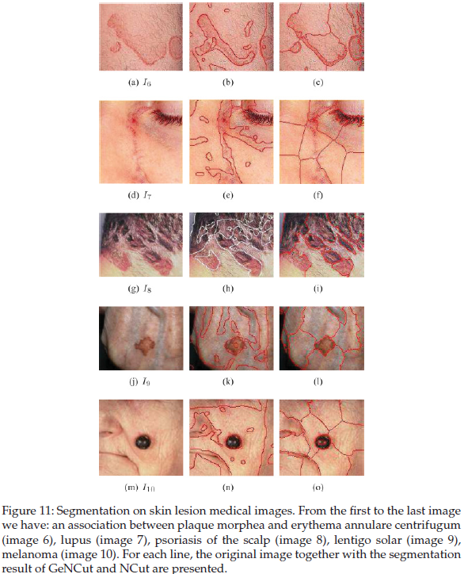
Experimental Result 4
Medical Images
Compare with NCut
Notes:
1 min

Slide 34
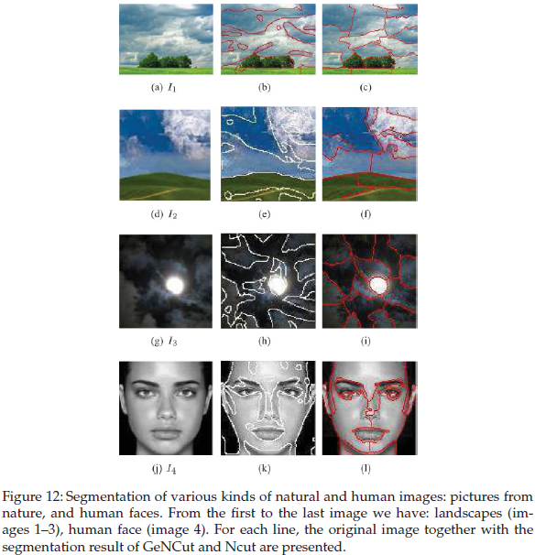
Experimental Result 5
Natural and Human Images
Compare with NCut
Notes:
1 min

Slide 35
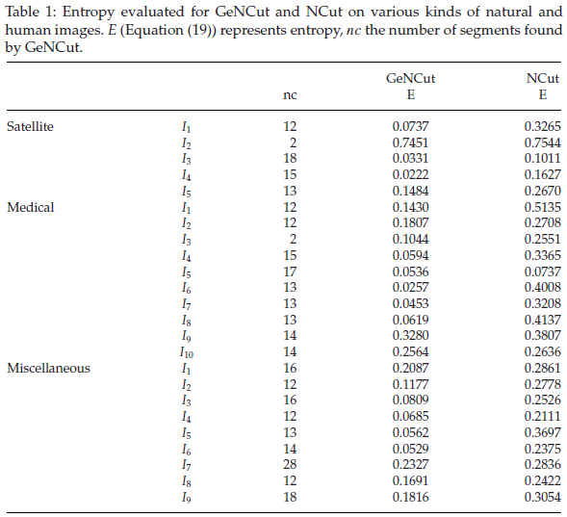
Experimental Result 6
Analyze by Entropy-Based Evaluation
Notes:
1 min

Slide 36
Comments
Exquisite usage of GA Algorithm to tackle the segmentation problem
New concept of nearest neighbor
Consider spatial location
Consider affinity among the pixels as well
Strength
Less parameters
Automatically
High accuracy
High robust
Notes:
3 min

Slide 37
Comments
Weakness
High computing-time comsumption
CPU: Four –core Intel Core i7
321x481 image, Population size =100, number of generations = 100 → 3.5min
Potential Research Directions
Extend to spectral-value images, not just gray-value image
Notes:
3 min

Slide 38
Thank you

